Slide 1

小喵小肥的農村日常
Tom and Jerrys Country Diary

Slide 2

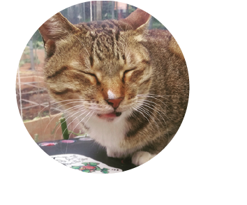



Members
Project Manager
農夫
設計師
工程師
生物學家

Slide 3
氣候變遷

Slide 4
青年農夫經驗傳承

Slide 5
How we face this problem

Slide 6


Slide 7
Core tech
Open Data by gov (Weather)
Open Crops Database
Diseases and Pests Warning System

